Slide 1


PROJECT TRUTHMINER
Mining through headlines to uncover real vs fake
Sergio Eguakun
Natalia Dominguez
Kaan Tirpanci
Zahory Vasquez

Slide 2

Table of Contents
1
2
3
4
5
6
7
8
Project Overview
Text Preprocessing & Feature Engineering
Models and evaluation
Transformer - distilBert
Test Data
Transfer learning
Evaluation & Accuracy Estimation
Conclusion

Slide 3

Project Overview
Goal:
• Classifying news headlines as either real (1) or fake (0)
Approaches:
• Data preprocessing
• Feature Engineering: TF-IDF
• Models and Evaluation
• Transformers (distilBert)
• Test data
• Transfer learning

Slide 4


Data Preprocessing
Steps taken here to clean the data involved :
Lowercase conversions
Removing stopwords
Removing unnecessary punctuations
Checking missing values and missing text
Ensuring Data Types were consistent throughout (str)
Fixing whitespace
Conclusion: The headlines show very little differences after implementing the text cleaning.

Slide 5

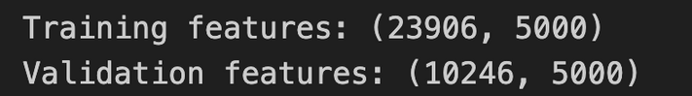
Feature Engineering:
Term Frequency–Inverse Document Frequency
(TF-IDF)
Create TF-IDF features
Parameters used for vectorizer here:
max features=5000
stop_words
ngram_range=(1,2)
max_df=0.95

Slide 6



Models and Evaluation
Model | Accuracy
Logical Regression | 0.9277
Naive Bayes | 0.9233
Random Forest Classifier | 0.9133
Linear SVM | 0.9319
XGBoost Classifier | 0.8751

Slide 7
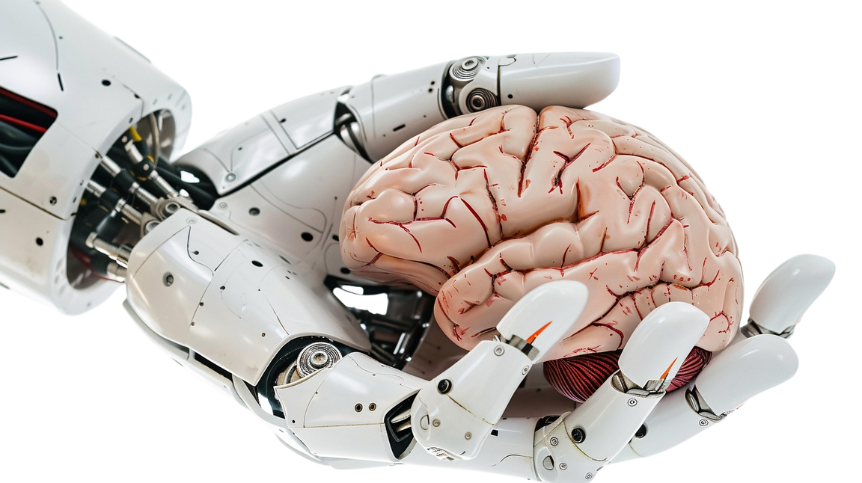
Transformer: distil
Bidirectional Encoder Representations
(distilBert)
DistilBert Transfer Model used without fitting on the data
Reason for this was to compare performance on Transfer models before and after fitting
Accuracy: 0.5493

Slide 8



Test Data
Data Preprocessing
Term Frequency–Inverse Document Frequency (TF-IDF)
Predictions

Slide 9

Transfer learning
Train the Pre-trained Model distilBERT and fit it with our data in order to generate better results
Transformers | Accuracy
distilBert | 0.5493
Training PTD | 0.9868

Slide 10

Conclusion
01
The best model was Linear SVM (0.9319)
02
After the transfer learning the accuracy improve (0.9868)

Slide 11
Thank you!

